Slide 1
BEAD Deployment: State of Michigan
Assessment of Supply Chain and Workforce

Slide 2
Understanding Core Challenges to Effectively Administer Michigan’s BEAD Deployment
Michigan Subgrantees
Success relies on a divers ecosystem of providers, from regional players and rural specialists to trusted electrical cooperatives and telcos
Executive Summary
State of Michigan: Bead Deployment
Corning, Prysmian, STL Produces
A Constrained & Concentrated Supply Chain
90% of fiber in US
Core Challenge: Federal "Build America, Buy America" (BABA) rules create a national choke point for fiber optic materials, with over 90% of supply controlled by just three companies
The Michigan Impact: This dynamic creates an "Allocation Risk" that penalizes small Michigan ISPs with punishingly long lead times (6+ months) and a cash-flow crisis from being forced to stockpile materials
Critical Path to Deployment
Michigan is poised to close its digital divide with a historic $1.56 billion BEAD investment. However, success is not guaranteed by funding alone. The primary challenge is execution. This analysis reveals three interconnected constraints that threaten the timeline, budget, and ultimate success of the program, particularly for the small, local providers essential for reaching our most remote communities.
Availability of Skilled Labor
Core Challenge: While the BEAD program requires a large, diverse workforce, there is a severe shortage of the most essential hands-on role: the Telecommunications Line Installer.
The Michigan Impact: Michigan's entire statewide pool consists of only ~2,050 of these critical workers, who are in a fierce "war for talent" with the high-paying energy sector, creating a severe human capital bottleneck
60% of technicians are nearing retirement.
Michigan needs to fill 1,750 new broadband jobs annually
Regulatory Delays & Seasonal Reality
Core Challenge: The MPSC-governed "make-ready" process for gaining access to utility poles creates a critical operational risk for project timelines
The Michigan Impact: A formal dispute can trigger a 180-day resolution timeline. This process consumes the majority of Michigan's ~6-month construction season, threatening to push project completion into the following year
Potential delays can push a project back a full year

Slide 3
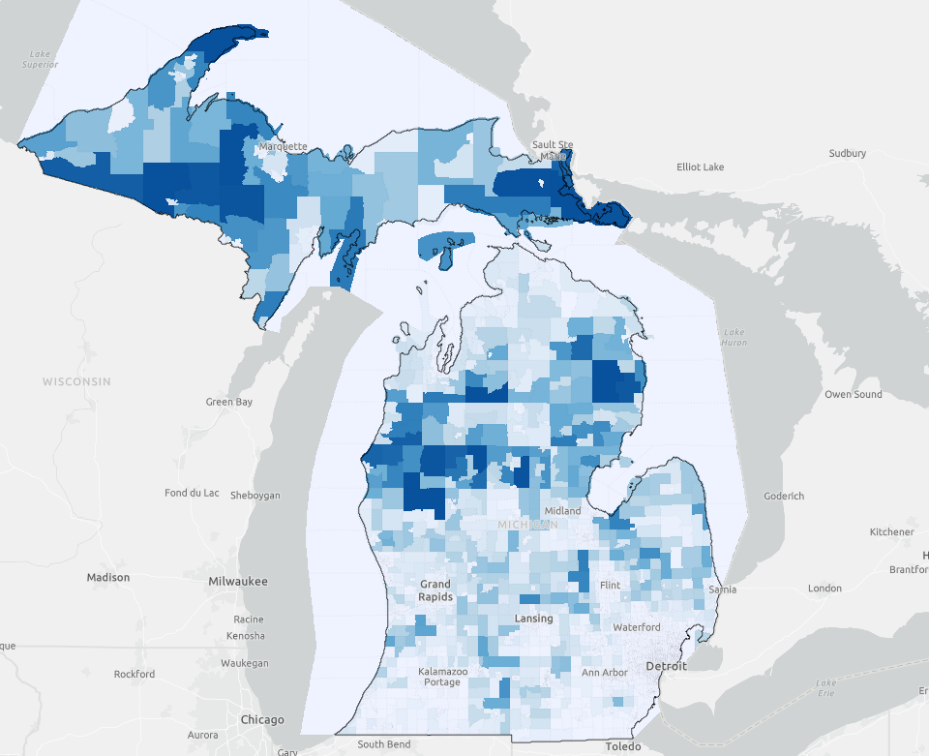
Michigan's $1.56B Mission: Connecting 500,000 Unserved Locations
Value Chain
State of Michigan: Lay of the land
The BEAD Mandate for Michigan
BEAD Eligible BSLs*
$1.559 Billion: Federal BEAD Program Allocation
>1500
750
0
~500,000 Unserved or Underserved Locations to Be Connected
2030: Target year for achieving universal connectivity
By the Numbers – Unserved and Underserved Locations
Status Category | Estimated Locations | Primary Geographic Concentration | Socio-Economic Impact
Unserved | ~210,000 - 244,000 ⁵ | Upper Peninsula, Northeast Lower Peninsula | Total exclusion from remote work, telehealth, and digital education.
Underserved | ~248,000 - 256,000 ¹ | Rural townships, suburban fringes | Limited ability to utilize high-bandwidth applications; digital frustration.
* BEAD Eligible BSLs (Broadband Service Locations): These are addresses lacking adequate internet, specifically those identified as unserved (under 25/3 Mbps) or underserved (under 100/20 Mbps)
Source: Michigan High-Speed Internet Office (MIHI), BEAD, accessed Jan ’26.

Slide 4
A Concentrated National Supply Chain Creates High Risk for Small ISPs
Value Chain
Broadband Value chain
The “Allocation Risk”: How Supply Constraints Disproportionately Impact Small ISPs
For a Michigan-based project, a 6-month lead time is not just a delay—it's a potential loss of an entire construction season. This risk threatens the viability of BEAD projects in the UP and Northern Lower Peninsula, where the building window is already severely truncated by winter weather
U.S. BABA-Compliant Fiber Market Concentration
Over 90% of the domestic supply for the entire BEAD program is controlled by just three corporate entities
Other
Lead Time (Weeks)
Prioritized Allocation
Working Capital (% of Material Cost)
STL / Sterlite
Tier 1 National Provider
15%
Favorable Payment Terms
Corning
De-Prioritized Allocation
Small Michigan ISP / Co-Op
Forced to Stockpile & Pre-Pay
100%
Prysmian Group
The Foundational BABA Rules: Understanding ‘Build American, Buy America’ (BABA)
Fiber Optic Cable | Enclosures & Hardware | Network Electronics
The Rule (Most Stringent): "BABA requires that 100% of the manufacturing process—from creating the core glass preforms to the final protective jacketing—must occur domestically. This is the most rigorous standard." | The Rule (Standard): "Covers items like cabinets, splice closures, and mounting hardware. As 'manufactured products,' all manufacturing processes must occur in the U.S. Any iron or steel components must also be domestically sourced." | The Rule (Specific Waivers): "BABA requires the final assembly and integration of active equipment to occur in the U.S. Some underlying components, like non-BABA compliant microchips, are permitted under a limited waiver."
Source: Secondary Research, Michigan High-Speed Internet Office (MIHI), NTIA, and Telecom industry reports. accessed Jan ’26.

Slide 5
The Flow of Broadband Materials is Governed by Two Realities: A National Capacity Limit for Fiber and the Local Priority System for Distribution.
Value Chain
Broadband Value chain
Optical Glass & Cable Manufacturing
Active Electronics
Distributor
Tier 1 Supplier
(Company | State | Product)
Tier 2 Supplier
(Company | State | Product)
Tier 3 Supplier
(Company | State | Product)
Corning | North Carolina | FlexNAP System
Calix | Michigan | Optical Line Terminal (OLT) Platforms
Graybar | Michigan | BABA-compliant SKUs
Sterlite Technologies | South Carolina | RapidRibbon Cables
Adtran | Alabama | OLT
ISPs | Michigan
Power & Tel | Michigan | Distributor
Prysmian | North and South Carolina | Fiber Cable
Nokia | Texas| OLT & ONTs
Large account ISPs sources directly from Tier 2 suppliers
Key Takeaways:
Michigan’s broadband expansion relies heavily on fiber‑optic materials and must comply with the Build America, Buy America (BABA) Act, requiring domestic production of covered materials for federally funded projects
Locally established firms benefit from local manufacturing, reducing shipping delays and transportation costs compared to reliance on distant suppliers
Sources: Secondary Research

Slide 6
A Few Specialized "Outside Plant" Roles Create a Critical Workforce Bottleneck
Workforce Analysis
Broadband Labor analytics
Macro View: Total Workforce Universe
A look at the diverse ecosystem of talent required for a successful deployment
Process View: Deployment Across Project Lifecycle
How workforce demand shifts and peaks from initial planning to long-term operations through the course of a project
Micro View: Pinpointed Bottleneck
Quantifying the gap between BEAD demand and Michigan's existing talent pool
Phase 1: Preconstruction
Phase 2: Construction & Deployment
Phase 3: Services & Operations
Supply Chain
Engineering
Skilled Field Labor
Function: Secure the grant, design the network, and obtain all necessary permits and approvals. | Function: Physically install the fiber optic infrastructure, from the "middle mile" to the customer's home. | Function: Activate customers, operate and maintain the live network, and provide ongoing support.
Key ISP Roles: • Project Management Specialists • Network Architects • Compliance Officers • Civil Engineers • Surveyors • Cost Estimators | Key ISP Roles: Construction Supervisors Equipment Operators & Engineers Telecommunications Line Installers Master and Stage Electricians Trenchers | Key ISP Roles: • Network Administrators • Customer Install Techs • Computer User Support • Customer Service Reps • Software Developers (OSS/BSS)
Occupation (SOC Code) | Current MI Employment | MI Projected Annual Openings | Key Challenge
Telecommunications Line Installers (49-9052) | ~2,050 | ~200 | CRITICAL: Severe shortage; long training cycle
Construction Supervisors (47-1011) | ~17,760 | ~1,400 | HIGH: Field leadership gap is a productivity bottleneck.
Operating Engineers (47-2073 ) | ~10,270 | ~860 | HIGH: Specialized role for underground boring
Project Management
PHASE 2
Key Takeaway:
The BEAD program requires a large, diverse ecosystem of talent. Nearly half of the workforce is in Supply Chain roles (laborers, material movers, trucking crews), while success also depends on Skilled Field Labor (equipment operators, fiber/wireless technicians, electricians, trenchers) and a strong Engineering backbone (network architects, RF & field engineers, software and structural engineers), supported by Project Management for coordination and compliance.
Key Takeaway:
The BEAD program requires a large, diverse ecosystem of talent. While over half the effort is in skilled field deployment, success is equally dependent on a strong backbone of project managers, engineers, and compliance specialists.
Key Takeaway:
The success of a BEAD grant ultimately funnels down to an ISP's ability to recruit from this small, hyper-competitive pool of specialized OSP workers. This is the single greatest point of failure in the workforce pipeline
Sources: ONet Data; all accessed in Jan’26

Slide 7
Scaling the broadband workforce requires filling both high-volume operational roles and critical engineering gaps
Workforce Analysis
Broadband Labor analytics
Significant concentration of the workforce in the Detroit metropolitan area
Robust labor pool in Southeast Michigan but indicates potential challenges in sourcing skilled labor in other parts of the state.
Michigan Current and Projected Employment
Workforce Availability
Toledo Metro
Grand Rapids Metro
Laborers & Material Movers
Trucking Crew
Structural Engineers
Software Engineers
Trenchers
Master and Stage Electricians
Equipment Operators
Inspectors
Network Architects
Fiber and Wireless Technicians
Michigan Non-Metro
Detroit Metro
Current Employment
Projected Employment (2032)
Michigan Projected Annual Openings (2022-2032)
Key Takeaway:
Key Skills & Demand: The largest number of projected openings are in Construction and Build, followed by a secondary, high-demand for Network Engineering and design roles.
Talent Concentration: The workforce is concentrated in a few high-volume technical roles, creating a risk of shortages in more specialized skills like Structural Engineers that are critical for new projects.
Laborers & Material Movers
Trucking Crew
Structural Engineers
Trenchers
Software Engineers
Master and Stage Electricians
Equipment Operators
Inspectors
Fiber and Wireless Technicians
Network Architects
Data Sources: ONet Data; all accessed in Jan’26

Slide 8
Four Interconnected Risks Threaten Project Timelines and Budgets Rationale
Implementation Risks
Broadband Risks and challenges
Potential Risks
Description
Impact
Critical Shortage of Skilled Labor
Gao exists between labor supply and the 1,750 new broadband jobs created annually. This is amplified by an aging workforce, with national data showing 60% of technicians are nearing retirement, and direct competition for talent in Michigan from the energy sector.
Project delays and inability to meet federally mandated BEAD deployment schedules.
Potential project cost increase due to contractor bidding wars
Seasonal Workforce Instability
Poses a significant risk to the 4-year BEAD project completion timeline, as a delay of even a few weeks can push work into the next year
Michigan’s climate restricts outdoor construction to a 6–7-month season, creating a "winter layoff" risk where skilled crews migrate, leading to a costly re-staffing challenge each spring, particularly in the Upper Peninsula.
Regulatory Delays: Pole Attachments
Because aerial construction is the only viable option in most rural areas, ISPs must gain access to existing utility poles. This involves a complex "make-ready" process to move existing wires and create space—all at the new ISP's expense. Disputes over costs and timelines (between ISPs and utility pole owners) are common and fall under the MPSC*'s jurisdiction, where a formal complaint can initiate a 180-day resolution timeline
Creates a critical path dependency that idles labor and prevents the efficient use of limited construction window.
Regulatory Risk to Supply Chain and Labor
The administrative overhead of BABA (restricting the material supply chain) poses a compliance risk, especially for the smaller, rural providers essential to Michigan's goals.
Poses a direct risk to the $1.56 billion in federal BEAD funding through potential non-compliance penalties or fund claw backs
*Michigan Public Service Commission
Key Takeaway:
These risks are not independent; they are interconnected. A regulatory delay consumes the short construction season, while a labor shortage makes every delay more expensive, creating a compounding threat to project viability
Source: Synthesized from U.S. Bureau of Labor Statistics, Fiber Broadband Association, Michigan High-Speed Internet Office, and Michigan Dept. of Labor & Economic Opportunity; accessed Jan ’26.

Slide 9
Michigan's Broadband Product Portfolio for BEAD Deployment
Product Portfolio
To connect ~200,000 locations with ~31,000 miles of new fiber, Michigan's BEAD program requires a specific portfolio of BABA-compliant products. The table below details these components, their key domestic suppliers, and the primary risks associated with their supply chains.
Product Category | Key BABA-Compliant Suppliers | Risk Level
Fiber Optic Cable | Corning (NY), CommScope (NC), Prysmian Group (SC), OFS/Furukawa (GA) | High Risk
Passive Optical Components (e.g., splitters, connectors, and distribution terminals) | CommScope & Corning (Terminals/Splitters) Clearfield (MN) Various overseas suppliers (Connectors) | Medium Risk
Network Electronics (OLTs, ONUs) | Adtran (AL) Calix (MI) Nokia (U.S. assembly) Cisco (CA) | High Risk
Conduit and Structural Materials (e.g. underground conduit, utility poles,etc.) | Dura-Line (TN) Oldcastle (Vaults) Stella-Jones (Wood Poles) | Medium Risk
Product Lead Time Estimates in Weeks (2022-2025)
Fiber Optic Cable
Passive Components
Network Electronics
Conduit and Materials
The broadband product portfolio reveals a challenging operational environment where unstable lead times, high supplier concentration, and rigid federal procurement rules create significant risks to the BEAD deployment timeline and budget.
Fiber Optic Cable: Highly volatile, with lead times swinging from a peak of 52-60 weeks to 4-10 weeks and projected to surge again. Strict BABA rules force reliance on a concentrated market of only ~5 domestic OEMs, creating a primary supply bottleneck.
Network Electronics: Vulnerable to global dependencies, with lead times exceeding 6+ months due to persistent chip shortages. BABA's U.S. assembly requirement does not mitigate risks from foreign components or potential ~5% cost increases from tariffs.
Passive Components: These are "almost exclusively" made abroad. Despite a BABA waiver, this import reliance makes projects highly vulnerable to international shipping and logistical delays that can halt construction.
Source: Research compiled from Michigan High-Speed Internet Office (MIHI), NTIA, The Pew Charitable Trusts, and Telecom industry reports. accessed Jan ’26.

Slide 10
Methodology, Assumption, and Accuracy
Appendix: methodology
Methodology
"Cost-to-Effort" Allocation Model: The core of the methodology is a "Cost-to-Effort" allocation model. The fundamental principle is that in a large-scale infrastructure project, the allocation of the budget is the most accurate proxy for the allocation of labor effort and complexity.
Establish the Universe of Roles: We began with the comprehensive list of 30+ relevant occupations obtained (from O*NET/BLS). This forms the complete "talent universe" required for a BEAD project.
Analyze a Typical Project Budget Breakdown: We applied a best-practice budget allocation model for a rural Fiber-to-the-Home (FTTH) project. While every project varies, a typical breakdown looks something like this:
Civil Works & Physical Construction (50-60%): This is the largest cost center, covering trenching, boring, pole attachments, and labor for placing conduit and fiber. This directly corresponds to the Skilled Field & Deployment category.
Materials & Equipment (20-25%): The cost of fiber, electronics, cabinets, etc. The labor associated with managing this falls under Supply Chain & Logistics and Project Management.
Engineering & "Soft Costs" (15-20%): This includes network design, surveying, permitting, project management, legal, and administrative overhead. This corresponds directly to the Engineering & Design and Project Management & Support categories.
Map Roles to Budget Categories: We then mapped each of the 30+ job roles to these primary cost/effort centers. For example:
The wages for Line Installers, Equipment Operators, and Laborers fall directly under "Civil Works & Physical Construction.“
The salaries for Project Managers, Compliance Officers, and Purchasing Agents fall under "Engineering & Soft Costs.“
Synthesize into Strategic Categories: The final step is to aggregate these detailed mappings into the four high-level, strategic categories for the pie chart. The percentages are the direct output of this budget-to-effort allocation model. This provides a far more accurate picture of project effort than simply summing total statewide employment for each role.

